Slide 1
Affordance-Grasp Conditioned
Spill-Free Trajectory Optimization
Does how you grasp a cup change how safely you can carry it?
Jihoon Yun · Motion Planning · 2026-06-08

Slide 2
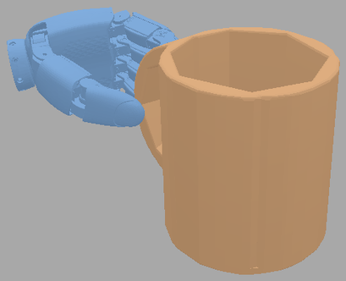
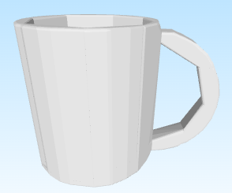
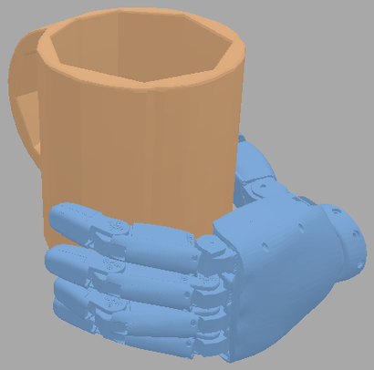
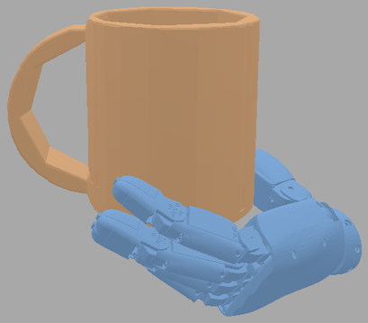
My thesis picks the grasp — this project plans the carry
MY THESIS · Affordance & taxonomy-aware grasp pose generation
THIS PROJECT · spill-free carry (motion planning)
grasp pose + start & goal EE poses
drink
object mesh
Grasp
generation
Spill-free trajectory optimization
(CHOMP + spill cost)
pour
task desciption
"pour" / "drink" / "hand over"
hand-over
start
goal
no-spill SE(3) carry trajectory
Motion-aware grasp generator
2

Slide 3
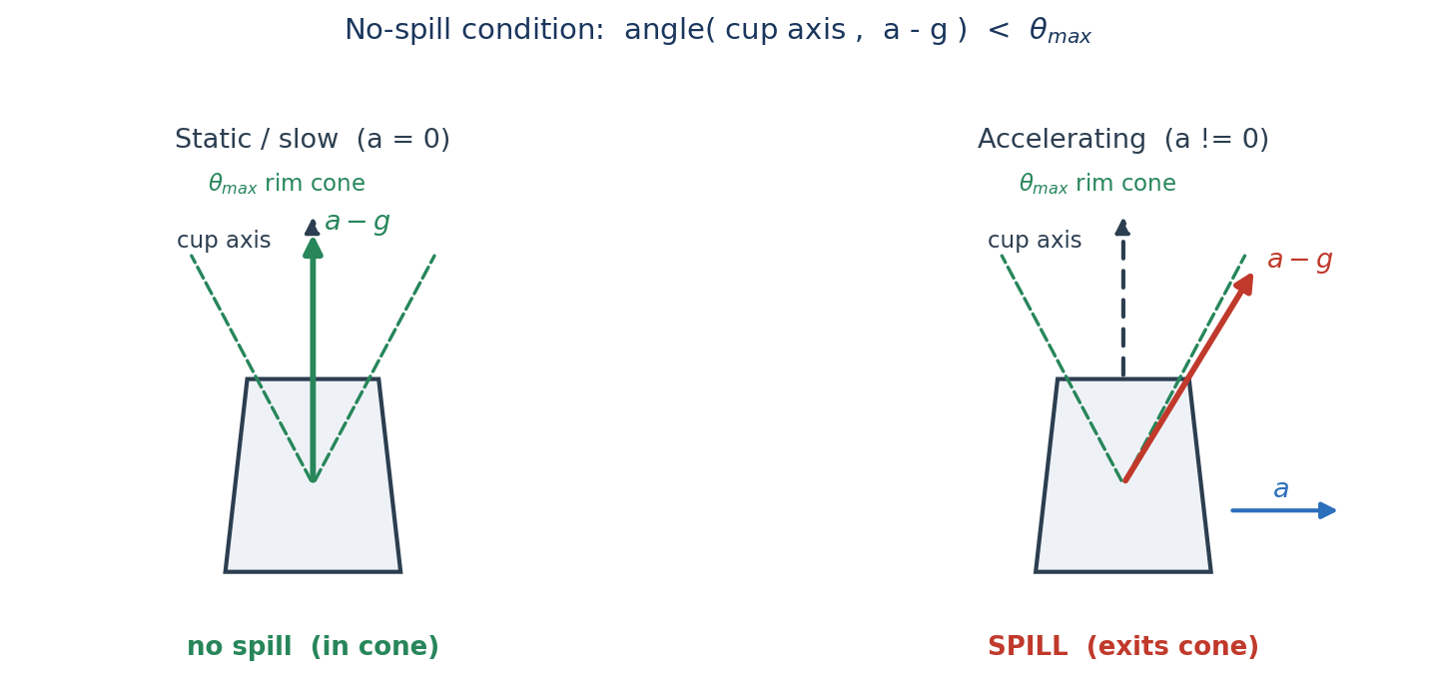
Problem — carry liquid from A to B without spilling
Given a grasped mug, plan a 6-DoF end-effector trajectory that is:
(a) spill-free (b) obstacle-avoiding (c) smooth
3
No-spill ⇔ the apparent-up vector a_cup − g stays inside the cup's rim cone

Slide 4


Why the grasp matters — it reshapes the spill margin
$$a_{cup}$$
$$a_{ee}$$
$$a_{cup}$$
$$α(same)$$
$$a_{ee}$$
r
r
$$α(same)$$
$$a_{cup}=a_{ee}+α×r+ω×(ω×r)$$
1. Different spill margin
Same arm motion / different grasp → different cup acceleration → different spill margin.
2. Different arm reachability
some grasps keep the cup upright easily, others don't.
5

Slide 5
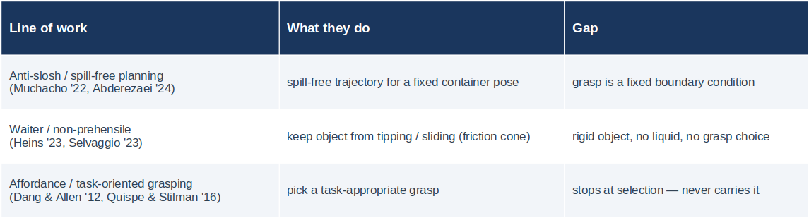
Related work & the gap
Nobody connects grasp choice to a physical spill margin. We make the trajectory optimizer score grasps by how safely they carry.
6

Slide 6
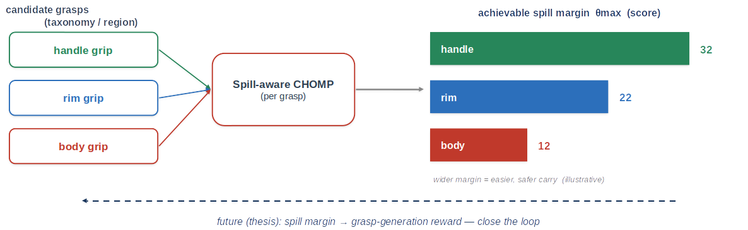

Method — spill-aware CHOMP
$J(ξ)=J_{smooth}+J_{obs}+λ_{s}J_{spill}$ ξ ← ξ − η A⁻¹ ∇J(ξ)
$J_{spill}=\sum_{t}{{max(0,cosθ_{max}−n∙\hat{u})}^{2}}$ $\hat{u}=\frac{a-g}{\left\|a-g\right\|}$
Achievable margin to spill cone (score)
7

Slide 7
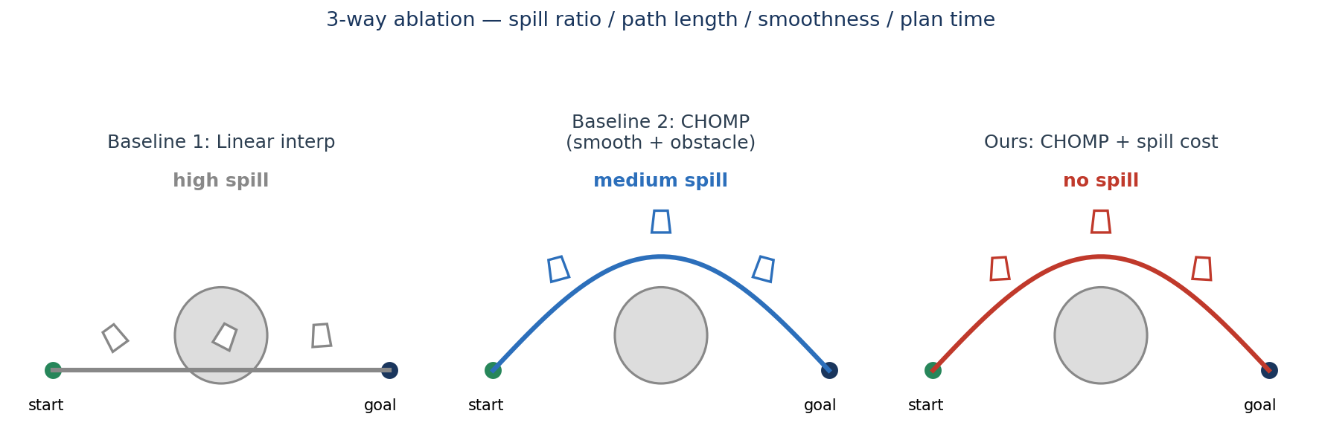
Evaluation & plan
• 3-way ablation: linear interp / CHOMP / CHOMP + spill — on a mug, with and without obstacles.
• Metrics: spill ratio, path length, smoothness (jerk), plan time; run across grasps to show the margin differs.
• Demo: SAPIEN particles on the liquid surface → count how many cross the rim.
• Timeline: implementation + ablation within ~1 week (proposal 06-08 → report 06-15).
9

